Slide 1
Chapter 6 Review:
Introduction to SQL
Modern Database Management
10th Edition
Jeffrey A. Hoffer, V. Ramesh,
Heikki Topi
© 2011 Pearson Education, Inc. Publishing as Prentice Hall

Slide 2
SQL Overview
Structured Query Language
The standard for relational database management systems (RDBMS)
RDBMS: A database management system that manages data as a collection of tables in which all relationships are represented by common values in related tables

Slide 3
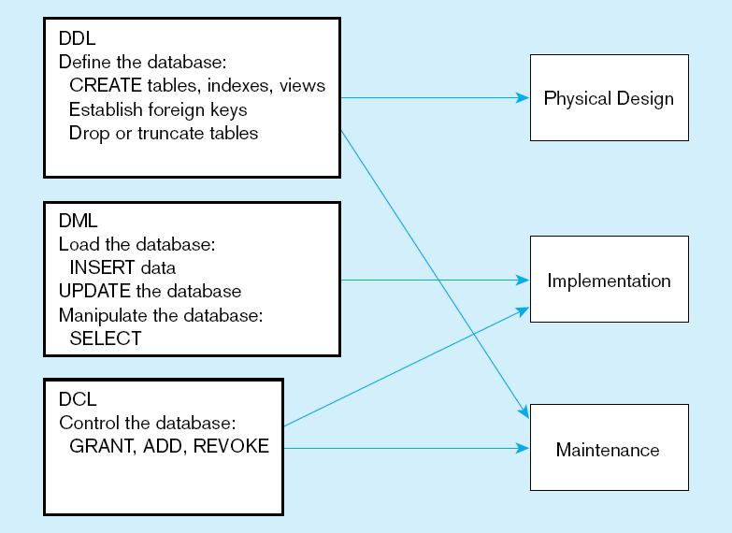
Figure 6-4
DDL, DML, DCL, and the database development process

Slide 4
SQL Database Definition
Data Definition Language (DDL)
Major CREATE statements:
  CREATE SCHEMA–defines a portion of the database owned by a particular user
  CREATE TABLE–defines a new table and its columns
  CREATE VIEW–defines a logical table from one or more tables or views
Other CREATE statements: CHARACTER SET, COLLATION, TRANSLATION, ASSERTION, DOMAIN
Notes:
CREATE SCHEMA
CREATE TABLE
CREATE VIEW
CREATE INDEX
CREATE STORED PROCEDUCTION
CREATE FUNCTION

Slide 5
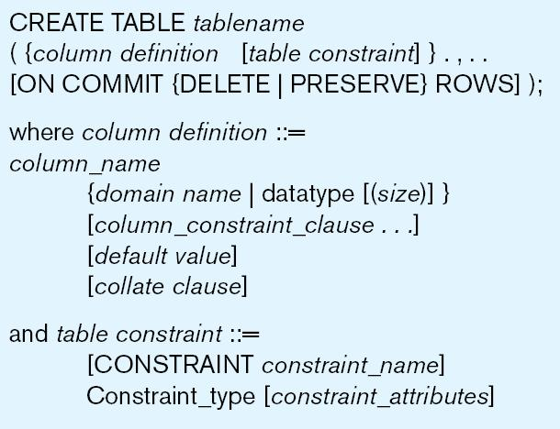
Table Creation
Steps in table creation:
Identify data types for attributes
Identify columns that can and cannot be null
Identify columns that must be unique (candidate keys)
Identify primary key–foreign key mates
Determine default values
Identify constraints on columns (domain specifications)
Create the table and associated indexes
Figure 6-5 General syntax for CREATE TABLE statement used in data definition language
Notes:
1 Identify data types for attributes – the name of each column, and their data types
2 Identify columns that can and cannot be null – optional
¾ Candidate key, and primary keys
5 default values
6 Constraints
7 tables and constatrainsts

Slide 6
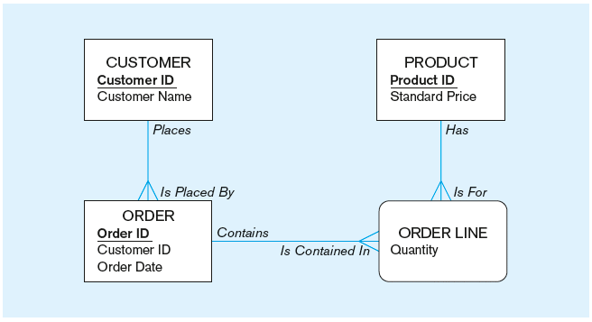
The following slides create tables for this enterprise data model
(from Chapter 1, Figure 1-3)

Slide 7
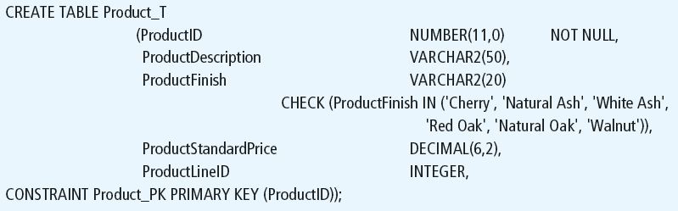
Defining attributes and their data types

Slide 8
Non-nullable specification
Primary keys can never have NULL values
Identifying primary key

Slide 9
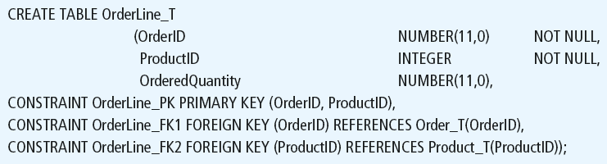
Non-nullable specifications
Primary key
Some primary keys are composite– composed of multiple attributes

Slide 10
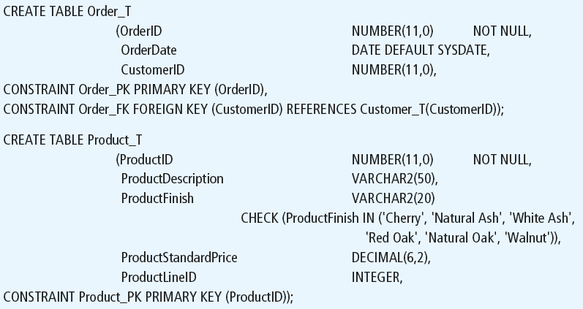
Controlling the values in attributes
Default value
Domain constraint

Slide 11
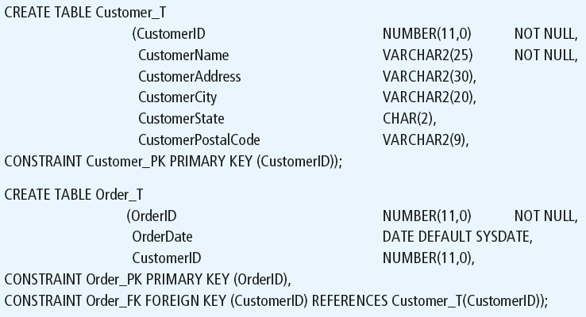
Identifying foreign keys and establishing relationships
Primary key of parent table
Foreign key of dependent table

Slide 12
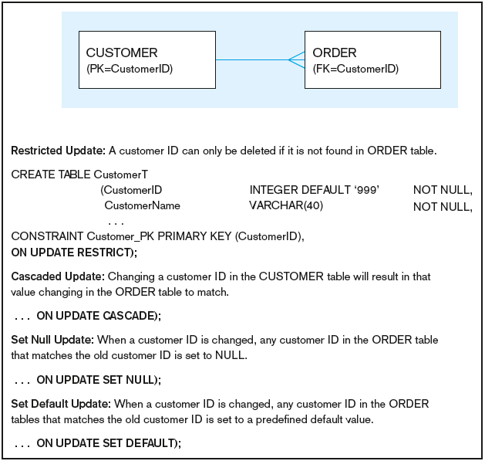
Figure 6-7 Ensuring data integrity through updates
Relational integrity is enforced via the primary-key to foreign-key match

Slide 13
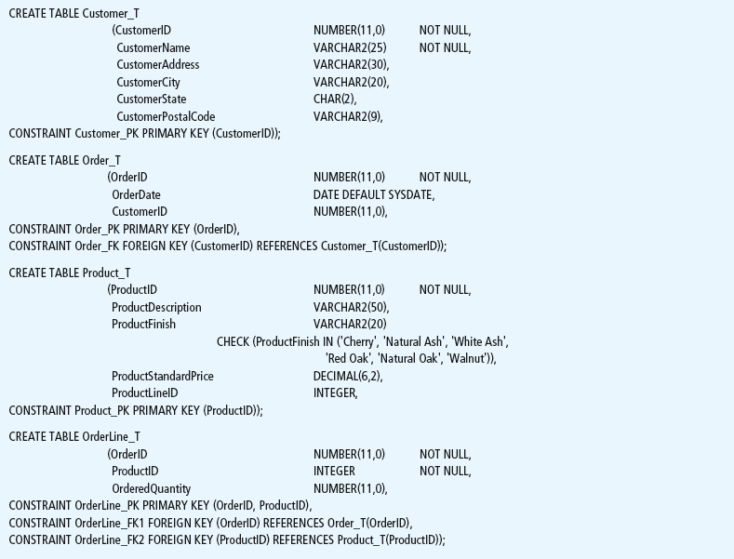
Figure 6-6 SQL database definition commands for Pine Valley Furniture Company (Oracle 11g)
Overall table definitions
Notes:
Take 10 minutes to create the structure using your CASE tool, your IDE. SQL Server Management Studio

Slide 14

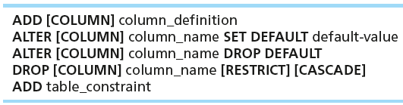

Changing Tables
ALTER TABLE statement allows you to change column specifications:
Table Actions:
Example (adding a new column with a default value):
Notes:
Ask students to Alter the column
Another DDL statement

Slide 15
Removing Tables
DROP TABLE statement allows you to remove tables from your schema:
  DROP TABLE CUSTOMER_T
Notes:
DROP table is another DDL

Slide 16



Insert Statement
Adds one or more rows to a table
Inserting into a table
Inserting a record that has some null attributes requires identifying the fields that actually get data
Inserting from another table
Notes:
Have students perform this function

Slide 17
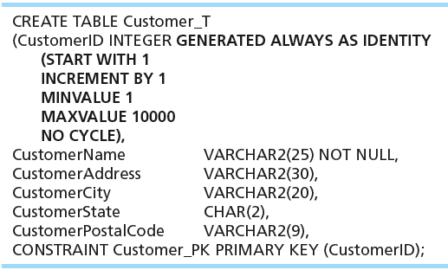
Creating Tables with Identity Columns
Inserting into a table does not require explicit customer ID entry or field list
  INSERT INTO CUSTOMER_T VALUES ( ‘Contemporary Casuals’, ‘1355 S. Himes Blvd.’, ‘Gainesville’, ‘FL’, 32601);
Notes:
That’s a IBM DB2 syntax, also same syntax as Oracle 12c
Prior to Oracle 12c, Oracle used a combination of sequence and triggers.
SQL Server: Identity (1,1)
MySQL: AUTO_INCREMENT

Slide 18
Delete Statement
Removes rows from a table
Delete certain rows
  DELETE FROM CUSTOMER_T WHERE CUSTOMERSTATE = ‘HI’;
Delete all rows
  DELETE FROM CUSTOMER_T;

Slide 19

Update Statement
Modifies data in existing rows

Slide 20
SELECT Statement
Used for queries on single or multiple tables
Clauses of the SELECT statement:
  SELECT
    List the columns (and expressions) that should be returned from the query
  FROM
    Indicate the table(s) or view(s) from which data will be obtained
  WHERE
    Indicate the conditions under which a row will be included in the result
  GROUP BY
    Indicate categorization of results
  HAVING
    Indicate the conditions under which a category (group) will be included
  ORDER BY
    Sorts the result according to specified criteria

Slide 21
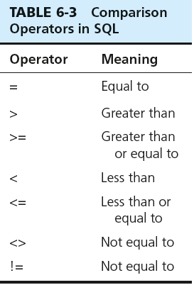

SELECT Example
Find products with standard price less than $275
Table 6-3: Comparison Operators in SQL
Notes:
Show the operators
Go back to SSMS and query the database!

Slide 22
SELECT Example Using Alias
Alias is an alternative column or table name
    SELECT CUST.CUSTOMERNAME AS NAME, CUST.CUSTOMERADDRESS
    FROM CUSTOMER_V CUST
    WHERE NAME = ‘Home Furnishings’;

Slide 23
SELECT Example
Using a Function
Using the COUNT aggregate function to find totals
  SELECT COUNT(*) FROM ORDERLINE_T
  WHERE ORDERID = 1004;
  Note: with aggregate functions you can’t have single-valued columns included in the SELECT clause, unless they are included in the GROUP BY clause

Slide 24

SELECT Example–
Categorizing Results Using the GROUP BY Clause
For use with aggregate functions
  Scalar aggregate: single value returned from SQL query with aggregate function
  Vector aggregate: multiple values returned from SQL query with aggregate function (via GROUP BY)
  Note: you can use single-value fields with aggregate functions if they are included in the GROUP BY clause

Slide 25
Aggregate Function syntax
  SELECT expression1, expression2, ... expression_n,
  aggregate_function1 (aggregate_expression),
  aggregate_function2 (aggregate_expression)
  FROM tables
  [WHERE conditions]
  GROUP BY expression1, expression2, ... expression_n
  [ORDER BY expression [ ASC | DESC ]];
Notes:
Expression1 , 2 , 3 are non aggregates.
You may have more than one aggregate functions in a SELECT expression
All non aggregate expressions must included in the group by clause

Slide 26
Aggregate Functions
  SUM -> summation
  MIN -> to find the lowest or minimum
  MAX -> to find the highest or maximum
  AVG -> mean
  COUNT -> how may records
Notes:
There are many others, depending on the DBMS system you are using.
STD Deviation of a population
STD Devation of a sample
VAR of Popluation
VAR of a population

Slide 27
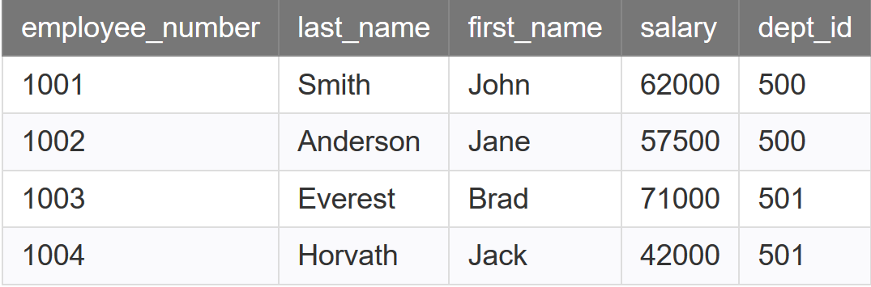
Aggregate function Example
  Table Name: Employees.
  Write SQL to display total salary by dept_id

Slide 28
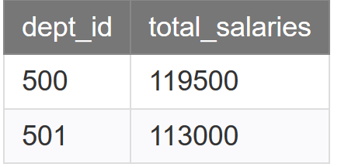
Aggregate function Example
  SELECT dept_id, SUM(salary) AS total_salaries
  FROM employees
  GROUP BY dept_id;

Slide 29
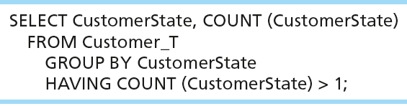
SELECT Example–
Qualifying Results by Categories
Using the HAVING Clause
For use with GROUP BY
  Like a WHERE clause, but it operates on groups (categories), not on individual rows. Here, only those groups with total numbers greater than 1 will be included in final result.

Slide 30
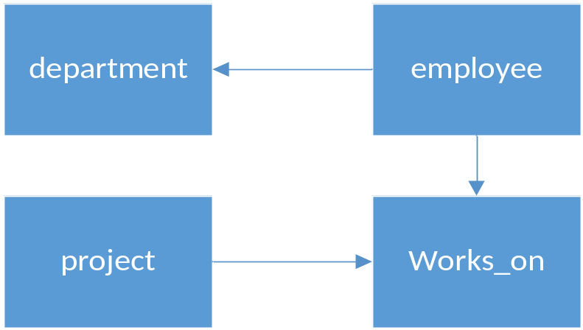
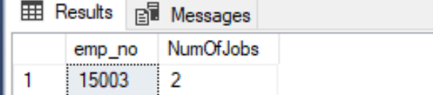
Aggregate Exercise 1: example from sample db
INSERT INTO works_on values ( 15003, ‘p2’, 'SQL Developer', '2019-02-01')
Write a SQL query to return employee numbers (emp_no) with at least two jobs.
Notes:
select emp_no, count(*)
from works_on
group by emp_no
having count(*)>1

Slide 31
SELECT DISTINCT
  Write a SQL that returns a list of dept_id from the Employees table

Slide 32
SELECT DISTINCT
  SELECT DISTINCT dept_id
  FROM EMPLOYEE;
  Results
Dept_id
500
501

Slide 33
SELECT DISTINCT in Aggregate Function
  SELECT expression1, expression2, ... expression_n,
  aggregate_function1 (DISTINCT aggregate_expression),
  aggregate_function2 (aggregate_expression)
  FROM tables
  [WHERE conditions]
  GROUP BY expression1, expression2, ... expression_n
  [ORDER BY expression [ ASC | DESC ]];

Slide 34
SELECT DISTINCT
  Write a SQL that returns a count of dept_id from the Employees table

Slide 35
SELECT DISTINCT in Aggregate Function
  SELECT COUNT(DISTINCT dept_id) AS total_dept
  FROM EMPLOYEES;
  Results
Total_dept
2

Slide 36
Using and Defining Views
Views provide users controlled access to tables
Base Table–table containing the raw data
Dynamic View
  A “virtual table” created dynamically upon request by a user
  No data actually stored; instead data from base table made available to user
  Based on SQL SELECT statement on base tables or other views
Materialized View
  Copy or replication of data
  Data actually stored
  Must be refreshed periodically to match the corresponding base tables
Notes:
Materialized views in Oracle, they are called Indexed views in SQL Server which are based on clustered index

Slide 37
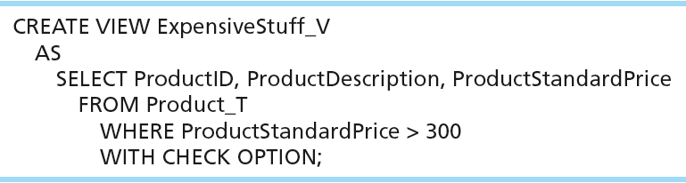
Sample CREATE VIEW
View has a name
View is based on a SELECT statement
CHECK_OPTION works only for updateable views and prevents updates that would create rows not included in the view
Notes:
Materialized views

Slide 38
Advantages of Views
Simplify query commands
Assist with data security (but don't rely on views for security, there are more important security measures)
Enhance programming productivity
Contain most current base table data
Use little storage space
Provide customized view for user
Establish physical data independence

Slide 39
VIEW Exercise
Create a view EmployeeList that shows a list of employees. Following columns:
Emp_no
FullName (first + last)
Notes:
create view EmployeeList AS
select emp_no, emp_fname + ' ' + emp_lname aS FullName
from employee
select * from EmployeeList

